Slide 1
PDAT611: Big Data Management
Module 2: Expanding Tidyverse

Slide 2
PDAT 611: Modules and Course Goals
1: Why is Big Data Management Important?
2: Expanding Tidyverse
3: Web Scraping and JSON
4: Databases: object-relational mapping, SQL, noSQL
5: Distributed Computing; using pig w/Hadoop
6: Sparklyr, Apache Spark through R
7: Google Cloud, AWS, and other cloud solutions
8: Exploring Big Data Issues and Opportunities.

Slide 3
Tidyverse Packages
https://www.tidyverse.org/packages/
Packages we already use all the time
ggplot2
dplyr
tidyr
readr
Helper (embedded/hidden) packages
magrittr
tibble
rmarkdown

Slide 4
New Packages to explore
Particular kinds of data
*lubridate – dates and times
forcats - factors
stringr – strings and regular expressions
Coding Techniques
purrr
Why we avoid loops
*sparklyr,
*dbplyr, others, (in a later module)

Slide 5
Tidyverse Cheatsheets
No one memorizes things from these
What’s the code for the Time Zone in India?
How do we put a star on a scatterplot?
Download these cheatsheets
https://rstudio.com/resources/cheatsheets/
Maybe even print them in color
Update cycle about every two years
Drafts available on github
Maybe you can help improve them

Slide 6
Tidyverse embedded, adjacent and more
Installing tidyverse installs all of these
You may need to update R or RStudio first
tidyverse_update()
library(tidyverse) installs “core” packages
Tidyverse-adjacent
lubridate, dbplyr installed, not loaded.
More at: https://tidyverse.tidyverse.org/

Slide 7

The lubridate package
Dates, Times
Regular Expressions

Slide 8
Time is tricky; time/date math is more tricky
Do you want to think about?
Day/Time formats
Time zones
Leap Years; Leap Seconds
Daylight Saving Time
Epochs and coding problems
Y2K
2038 is still worrying people
How many days until my birthday?
Avoid writing time-handling code yourself

Slide 9
Date and POSIXct classes
Date: “Dates are represented as the number of days since 1970-01-01, with negative values for earlier dates. They are always printed following the rules of the current Gregorian calendar.”
POSIXct: “The (signed) number of seconds since the beginning of 1970 (in the UTC time zone) as a numeric vector.”
Use only these two classes
Allows time math, graphing, etc
Thus, only input/out is a concern

Slide 10
parsing dates and times in standard forms
parse command names match component order
ymd(), ydm()
mdy(), myd()
dmy(), dym()
ymd_hms(), ymd_hm(),
ymd_h(), etc.
All-purpose command
parse_date_time()
Watch timezones!
PiDates <- c("3/14/21", "Mar 14th, 1988") PiTimes <- c("3/14/21 13:03:30", "Mar 14th, 1988, 1:03:30 pm")
# Base R as.Date(PiDates, format="%m/%d/%y")
[1] "2021-02-18" NA
as.POSIXct(PiTimes, format="%m/%d/%y %H:%M:%S")
[1] “2021-03-14 13:03:30 CST" NA
# Lubridate library(lubridate) mdy(PiDates)
[1] "2021-03-14" "1988-03-14“
mdy_hms(PiTimes)
[1] "2021-03-14 13:03:30 UTC" "1988-03-14 13:03:30 UTC"

Slide 11
Time zones hurt our head
“UTC” stands for “Coordinated Universal Time,” and is not a “live” time zone
If not specified, defaults differ!
Location-based names account for daylight savings time.
OlsonNames( )
Sys.timezone( )
wintr.day <- "2021-02-14 13:03:30"
sumr.day <- "2021-07-04 13:03:30"
# Base R - System Time Zone
as.POSIXct(wintr.day)
[1] "2021-02-14 13:03:30 CST"
# Lubridate - UTC
ymd_hms(wintr.day)
[1] "2021-02-14 13:03:30 UTC"
# Specify `tz` to be sure.
ymd_hms(wintr.day,tz="America/Chicago")
[1] "2021-02-14 13:03:30 CST"
ymd_hms(sumr.day, tz="America/Chicago")
[1] "2021-07-04 13:03:30 CDT"

Slide 12
lubridate will work with date/time parts
Components of date and time:
date(), year(), month(), day(), hour(), minute(), second()
Other derived quantities:
wday(): Day of the week
qday(): Day of the quarter
week(): Week of the year
quarter(), semester(),
am(), pm(), dst(), leap_year()
Variant commands for technical standards:
isoyear(), epiyear(),
isoweek(), epiweek()
wintr.day<-"2021-02-14 13:03:30"
month(wintr.day)
[1] 3
week(wintr.day)
[1] 7
qday(wintr.day)
[1] 45
year(wintr.day) <- 2002
[1] "2002-02-14 13:03:30 UTC"
leap_year(wintr.day)
[1] FALSE

Slide 13
Addition adds seconds to times and days to dates.
wintr.day<- ymd_hms("2021-02-14 13:03:30",tz="America/Chicago")
wintr.date <- date(wintr.day)
wintr.day + 10 [1] "2021-02-14 13:03:40 CST"
wintr.day + months(10) [1] "2021-12-14 13:03:30 CST“
date + 45 [1] "2021-03-31“
date + months (45) [1] "2024-11-14“
date + years(45) [1] "2066-02-14"

Slide 14
fancier math uses periods or durations.
Periods increment clock or calendar, ignoring irregularities:
years(), months(), weeks(), days(), hours(), minutes(), seconds(), etc.
Durations increment physical time:
dyears(), dmonths(), dweeks(), ddays(), dhours(), dminutes(), dseconds(), etc.
PiDay <- ymd_hms("2021-03-14 01:30:00", tz="America/Chicago")
leapDay <- ymd("2020-02-29")
# Jump ahead on Clock Change
PiDay + hours(2)
[1] "2021-03-14 03:30:00 CDT”
PiDay + dhours(2)
[1] "2021-03-14 04:30:00 CDT“
# Leap Day doesn't exist in 2021 # A year's duration is 365.25 days.
leapDay + years(1)
[1] NA
date + dyears(1)
[1] "2021-02-28 06:00:00 UTC"

Slide 15
Question
Which of the following does lubridate not handle automatically? (Check all that apply.
Choosing the correct time zone, when not specified.
Interpreting multiple ways to represent days and months.
Understanding multiple delimiters between time components.
Inferring the correct order of years, months, days, etc., in a date.
Keeping track of daylight savings time and other timing quirks for a given time zone.

Slide 16


The forcats package
Working with Factor Variables

Slide 17
What’s a factor variable?
Categorical variable:
Has a “fixed or known” set of possible values
factors properly partition a space, “1:1 and onto”
Examples
Multiple Choice or Attitude Scale Questions
Pre-test / Post-test or Control/Experiment
In Statistics, we often use numbers (Ick)
1 = Strongly Agree, 2 = Agree, 3 = Neutral, etc.
Mathematics temptation is strong (and wrong)
Software convenience (in the 1960s)

Slide 18
How are strings and factors different?
Both are “categorical variables,” made of text
A factor has a list of possible values
Factors are needed for modelling: t.test, lm
A string is simply raw text, “everything else”
Sometimes, you can treat a factor as a string.
You almost never treat a string as a factor.
forcats is for factors
stringr is for strings (coming soon)

Slide 19
Importing data as a factor
df %>% mutate_if(is.character, factor)
When text is imported, how is it treated?
read.csv (…, StringsAsFactors=FALSE)
In older versions of R, StringsAsFactors = TRUE
read_csv treats all text as strings, never factors
Instead, process after loading as needed
Creates a reproducible “paper trail”
#“One Easy Trick” from dplyr
ProcessedData <- rawdata %>%
mutate_if(is.character, factor)

Slide 20
Ordered Factors
Factors may have an order
Natural order1 = first seen (by row)
Natural order2 = alphabet
Natural order3 = by frequency (Pareto)
Better to assign one explicitly
Ordered Factors are really Ordinal Variables
Display on a graph
Non-parametric analysis (a different class)

Slide 21
Manipulating Factors with forcats
Making a variable
factor()
Exploring a factor
levels( )
Many Commands are intuitive and start with fct_
fct_count(), fct_unique() fct_c(), fct_explicit_na(), fct_relevel(), fct_recode() fct_infreq(), fct_reorder(), fct_lump(), fct_drop(),
library(tidyverse) library(AmesHousing) Ames <- make_ordinal_ames
# Try these out to see what they yield
levels(Ames$KitchenQual) fct_count(Ames$Kitchen_Qual)
Ames$Kitchen_Qual %>% fct_rev() %>% fct_count()
Ames$Kitchen_Qual %>% fct_lump_min(72) %>% fct_count()
Ames$Kitchen_Qual %>% fct_infreq() %>% fct_count()

Slide 22

The stringr package
Working with String variables unfactored text

Slide 23
How are strings and factors different?
Both are “categorical variables,” made of text
A factor has a list of possible values
Factors are needed for modelling: t.test, lm
A string is simply raw text, “everything else”
A factor is not a string, although it might also be text
When text is imported, how is it treated?
read.csv (…, StringsAsFactors=FALSE)
In older versions of R, StringsAsFactors = TRUE
read_csv treats all text as strings, never factors
stringr CAN analyze factors as strings, if you need that.

Slide 24
stringr systematizes string manipulation.
Find matching strings.
Search for and extract substrings.
Measure and set string lengths.
Mutate strings.
Join and split strings.
Sort strings.
Get the stringr cheatsheet
https://rstudio.com/resources/cheatsheets/

Slide 25
Stringr patterns use regular expressions
“Regular expressions” use a special language to match characters in a string
Same regex structure as many other software languages
The stringr cheatsheet has a whole section on them
Pattern | Matched in “ABCDEFabcdef123456”
“Efabc” | Efabc
“.a..” | Fabc

Slide 26
strings use backslash to denote special characters.
Sequence | Meaning
\' | Single quote as part of the string
\" | Double quote as part of the string
\` | Back quote as part of the string
\n | Newline
\t | Tab
\\ | Actual Backslash
\xnn | Character with hex code nn
\Unnnnnnnn | Character with Unicode nnnnnnnn (1-8 digits)
Others | Type ?”’”

Slide 27
Manipulating Strings with stringr
Many Commands are intuitive and start with str_
str_detect(), str_count(), str_count(), str_which(), str_sub(), str_length(), str_sort(), str_replace(), str_to_upper(), str_title()
Combining these with regular expressions can allow interesting explorations and mutations
library(tidyverse) library(AmesHousing) Ames <- make_ordinal_ames
AmesNeigh <- fct_unique(Ames$Neighborhood)
# Try these out to see what they yield
str_to_upper(AmesNeigh) str_detect(AmesNeigh,"North") str_count(AmesNeigh,"North") str_extract(AmesNeigh,"North") str_extract(AmesNeigh,"No..") str_extract(AmesNeigh,"[:upper:]") str_locate(AmesNeigh,"North")
str_length(AmesNeigh) str_count(AmesNeigh,"\\w") str_count(AmesNeigh,"[A|a]")

Slide 28
stringr systematizes string manipulation.
A survey on basic income asked about perceived benefits of the idea as a “check all that apply” question
All responses were stored in one column, split by |. Ugh.
bi <- read.csv("data/basic_income_short_names.csv") head(bi$argpro, 10)
[1] "None of the above“ [2] "It increases appreciation for household work and volunteering | It [3] "It creates more equality of opportunity“ [4] "It reduces anxiety about financing basic needs" [5] "It reduces anxiety about financing basic needs“ [6] "It encourages financial independence and self-responsibility | It [7] "It reduces anxiety about financing basic needs“ [8] "It increases appreciation for household work and volunteering | It [9] "It creates more equality of opportunity | It reduces anxiety about [10] "It increases solidarity, because it is funded by everyone

Slide 29
What are the possible unique responses?
response.matrix <- str_split(bi$argpro, pattern=" \\| ", simplify=TRUE)
unique(as.vector(response.matrix))
[1] “None of the above"
[2] "It appreciation for household work and volunteering"
[3] "It creates more equality of opportunity"
[4] "It reduces anxiety about financing basic needs"
[5] "It encourages financial independence and self- responsibility"
[6] "It increases solidarity, because it is funded by everyone"
[7] "It reduces bureaucracy and administrative expenses"
[8] ""

Slide 30
Create T/F columns for each response.
bi$pro_none <- str_detect(bi$argpro, "None of the above") bi$pro_household <- str_detect(bi$argpro, "appreciation for household") bi$pro_equality <- str_detect(bi$argpro, "creates more equality") bi$pro_less_anx <- str_detect(bi$argpro, "reduces anxiety") bi$pro_indep <- str_detect(bi$argpro, "financial independence") bi$pro_solidarity <- str_detect(bi$argpro, "increases solidarity") bi$pro_less_bureaucracy <- str_detect(bi$argpro, "reduces bureaucracy") bi %>% select("pro_none":"pro_less_bureaucracy") %>% head()
# A tibble: 6 x 7
pro_none pro_household pro_equality pro_less_anx pro_indep pro_solidarity
<lgl> <lgl> <lgl> <lgl> <lgl> <lgl>
1 TRUE FALSE FALSE FALSE FALSE FALSE
2 FALSE TRUE FALSE TRUE TRUE FALSE
3 FALSE FALSE TRUE FALSE FALSE FALSE
4 FALSE FALSE FALSE TRUE FALSE FALSE
5 FALSE FALSE FALSE TRUE FALSE FALSE
6 FALSE FALSE FALSE TRUE TRUE FALSE
# ... with 1 more variable: pro_less_bureaucracy <lgl>

Slide 31
Making meaning from strings into binary variables
pro_chart <- bi %>%
select(vote,pro_none:pro_less_bureaucracy) %>% group_by(vote) %>%
summarize(none = round(mean(pro_none)*100),
house = round(mean(pro_household) *100),
anx = round(mean(pro_less_anx)*100),
equal = round(mean(pro_equality)*100),
indep = round(mean(pro_indep)*100),
solid = round(mean(pro_solidarity)*100),
beau = round(mean(pro_less_bureaucracy)*100)
)
pro_chart
# A tibble: 5 x 8
vote none house anx equal indep solid beau
* <chr> <dbl> <dbl> <dbl> <dbl> <dbl> <dbl> <dbl>
1 I would not vote 64 8 12 12 9 7 6
2 I would probably vote against it 31 15 34 18 13 13 15
3 I would probably vote for it 10 24 46 36 27 25 17
4 I would vote against it 53 13 22 9 7 8 9
5 I would vote for it 5 28 55 46 33 32 20

Slide 32

The purrr package
Vectorized Functions (aka: How to avoid loops)

Slide 33
Loops provide a way to repeat things
Common technique in “normal” programming
We might want them as well:
Apply the same function to a list of numbers.
Calculate the mean of several columns in your data frame.
Calculate a summary for several subgroups within your data.
Calculate results for different assumptions.
Create a simulation by using the computer to create many random outcomes.

Slide 34
R is known for avoiding loops
R is famously slow at running loops.
Call R from C++ if you NEED a lot of loops
Instead, we prefer to use vectorized functions
Plug in a vector of inputs
Get out a vector of outputs
purrr is the tidyverse package for this
Command: map (and friends)
Other ways we can do this
dplyr: summarize with group_by
baseR: apply, lapply, sapply, tapply, and vapply
commands: colMeans

Slide 35
Vectorized Functions avoid explicit loops
Many R functions accept a vector of values
Output is another vector
Is it loop? It looks through, I guess
Go back to AmesHousing
Multiple variables ended with “Area”
colMeans() calculates the mean of every column
Avoids running five commands (or a loop)
Ames %>% select(ends_with("Area")) %>% colMeans()
Lot_Area Mas_Vnr_Area Gr_Liv_Area Garage_Area Pool_Area
10147.921843 101.096928 1499.690444 472.658362 2.243345

Slide 36
The map command vectorizes any function
# map itself returns a "list“ # which is not very useful
Ames %>% select(ends_with("Area")) %>% map(mean)
$Lot_Area [1] 10147.92
$Mas_Vnr_Area [1] 101.0969
$Gr_Liv_Area [1] 1499.69
$Garage_Area [1] 472.6584
$Pool_Area [1] 2.243345
# map_dbl returns a # vector of numbers # much more useful.
Ames %>% select(ends_with("Area")) %>% map_dbl(mean)
Lot_Area Mas_Vnr_Area Gr_Liv_Area 10147.92 101.10 1499.69
Garage_Area Pool_Area 472.66 2.24

Slide 37
The map command vectorizes any function
#it works for most anything #single argument functions are easy
Ames %>% select(ends_with("Area")) %>% map_dbl(median)
Lot_Area Mas_Vnr_Area Gr_Liv_Area 9436.5 0.0 1442.0
Garage_Area Pool_Area 480.0 0.0
# Build fancier functions # Multiple argument functions # Use .x as a placeholder
Ames %>% select(ends_with("Area")) %>% map_dbl(~quantile(.x, .75))
Lot_Area Mas_Vnr_Area Gr_Liv_Area 11555.25 162.75 1742.75
Garage_Area Pool_Area 576.00 0.00

Slide 38
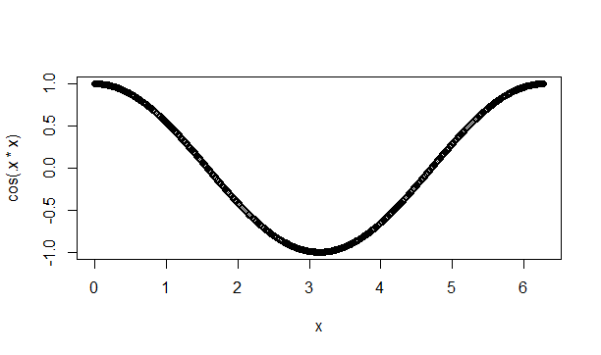
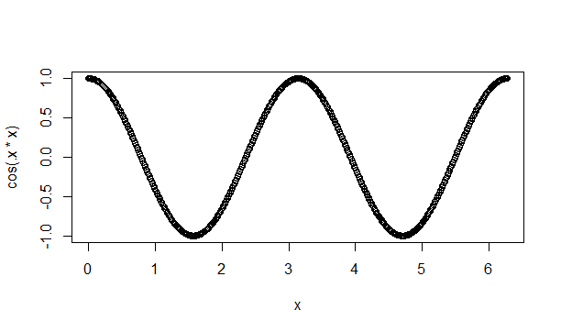
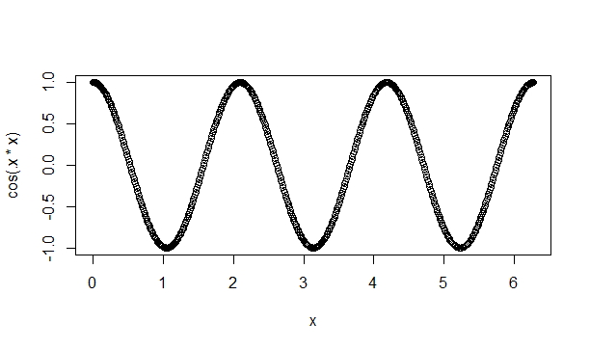
The map command can even make graphs
# Let’s say that I wanted to # create three plots of # cos(kx) for # k = 1, 2, 3 and 0 ≤ x ≤ 2π.
x <- seq(0, 2*pi, 0.01) k = c(1, 2, 3)
k %>% map(~ plot(x=x, y=cos(.x * x)))
# Note: This command takes the # place of these three: # plot(x=x, y=cos(1*x)) # plot(x=x, y=cos(2*x)) # plot(x=x, y=cos(3*x))

Slide 39
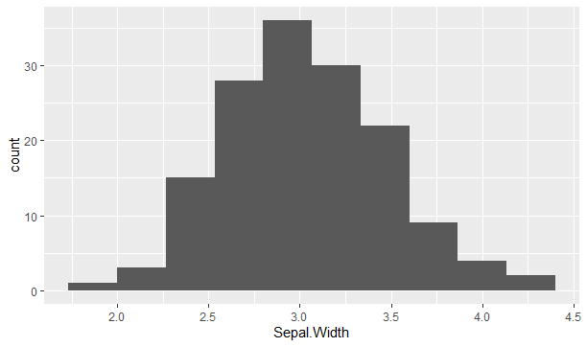
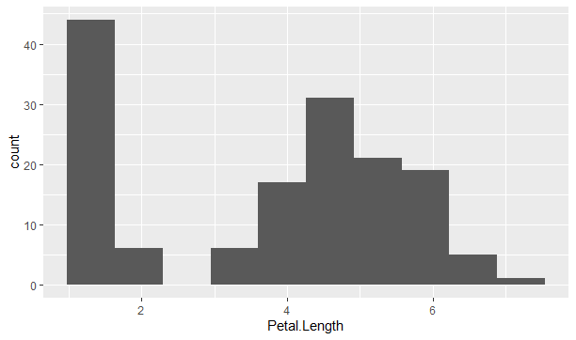
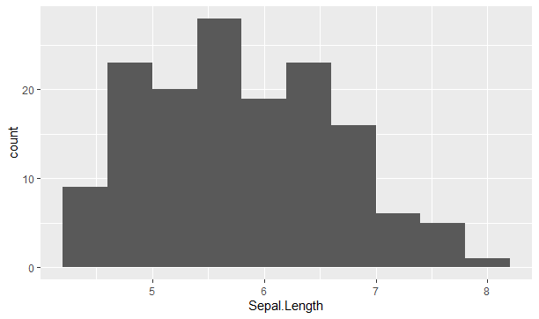
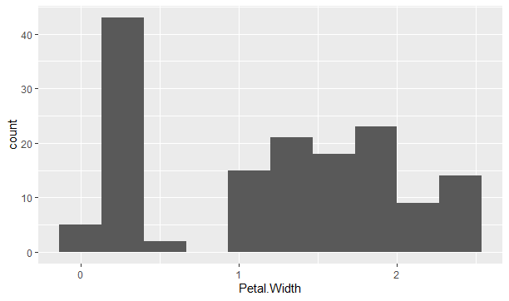
More graphing
iris %>% select(-Species) %>% names() %>% map(~ ggplot(iris) + geom_histogram(mapping = aes_string(x=.x), bins=10))

Slide 40
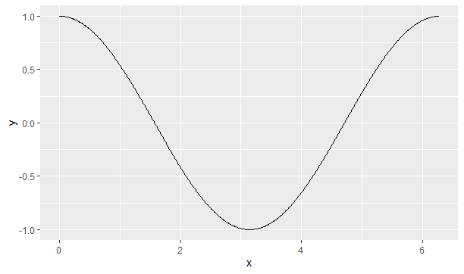
You can actually make loops in R
# Create vector of x values.
x.vec <- seq(0, 2*pi, by=0.01)
# Initialize empty y variable.
y.vec <- double()
# for loop calculates values # one-at-a-time and adds to # the vector y.
for(x in x.vec){ y = cos(x) y.vec <- c(y.vec, y) }
df <- data.frame(x=x.vec, y=y.vec)
ggplot(df) + geom_line(mapping=aes(x=x, y=y))
# That isn’t a curve # That’s 628 dots # Cool, but not very efficient

Slide 41
There’s more (but not here)
Other Tidyverse-adjacent packages
Importing particular types of data
blob, for binary data
modelr, for Creating models
dtplyr, dbplyr, and sparklyr
More at: https://tidyverse.tidyverse.org/
Don’t forget to obtain the cheatsheets

Slide 42
PDAT 611: Modules and Course Goals
1: Why is Big Data Management Important?
2: Expanding Tidyverse
3: Web Scraping and JSON
4: Databases: object-relational mapping, SQL, noSQL
5: Distributed Computing; using pig w/Hadoop
6: Sparklyr, Apache Spark through R
7: Google Cloud, AWS, and other cloud solutions
8: Exploring Big Data Issues and Opportunities.

